Slide 1
Design and Analysis of CRISPR Class 2, Type II, V, and VI Systems as Effective Treatments for Viral Infections
A promising new technology that can combat ALL TYPES OF VIRUSES

Slide 2
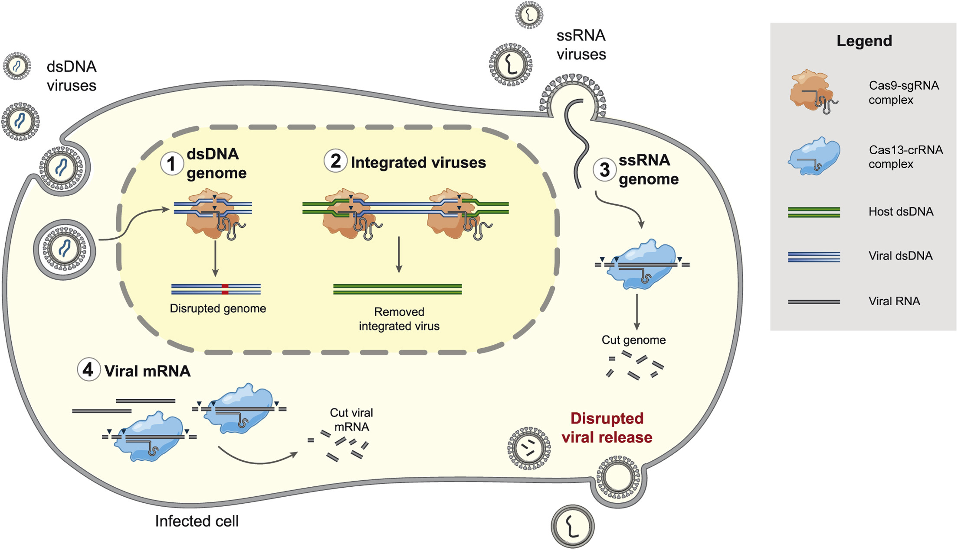
What is CRISPR?
Why is it Useful?
CRISPR-Mediated Antiviral Therapy (CMAVT)
Exploring CMAVT with
+ssRNA viruses (SARS-CoV-2)
-ssRNA viruses (Zaire Ebola)
dsDNA viruses (Herpes)
Choosing and design of expression vectors, with their delivery mechanisms.
CRISPR applications elsewhere
My crRNA
overview
Freije & Sabeti, Cell Host & Microbe, 2021

Slide 3


WHAT IS the crispr/cas system
CRISPR stands for Clustered Regularly Interspaced Short Palindromic Repeats
CAS stands for CRISPR Associated Proteins.
This system is an acquired immune system found in Bacteria and Archaea that directly cuts viral DNA/RNA.

Slide 4
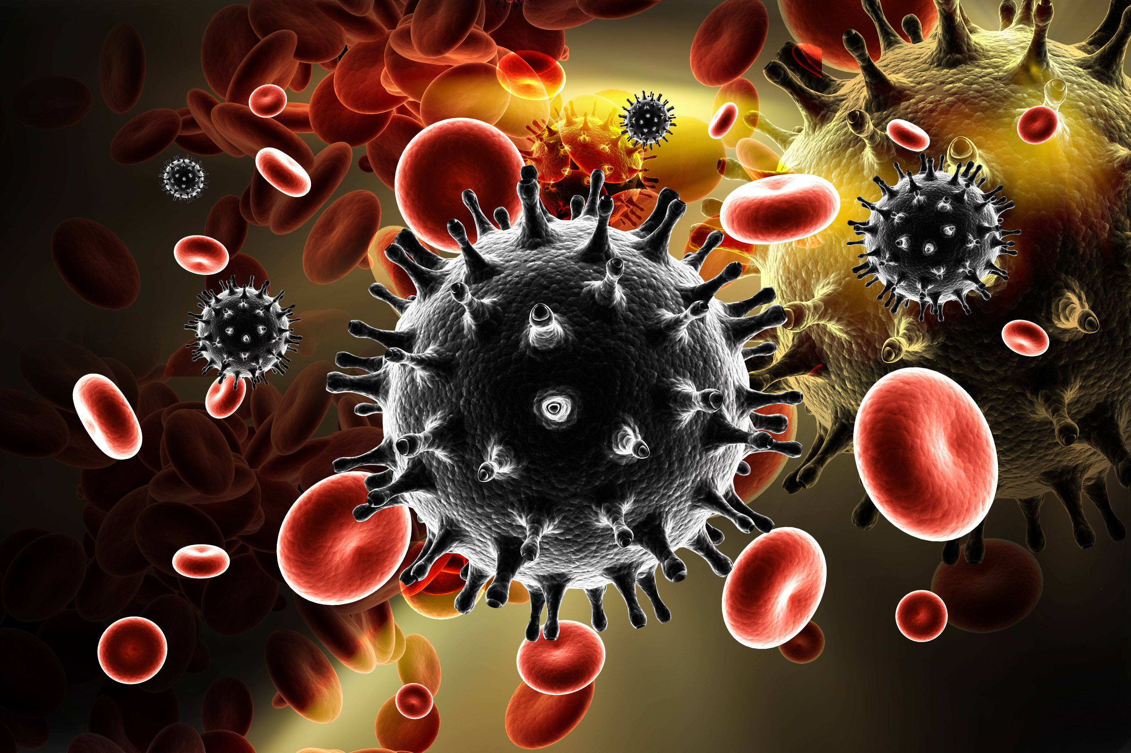

WHY CRISPR ?
Constant threat of newly emerging PPVs
Directly targets virus and supresses it.
Potential cure for latent infections (HIV)
Hard to evade by the virus

Slide 5
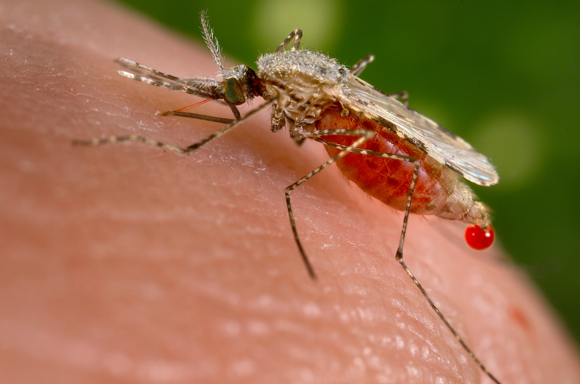
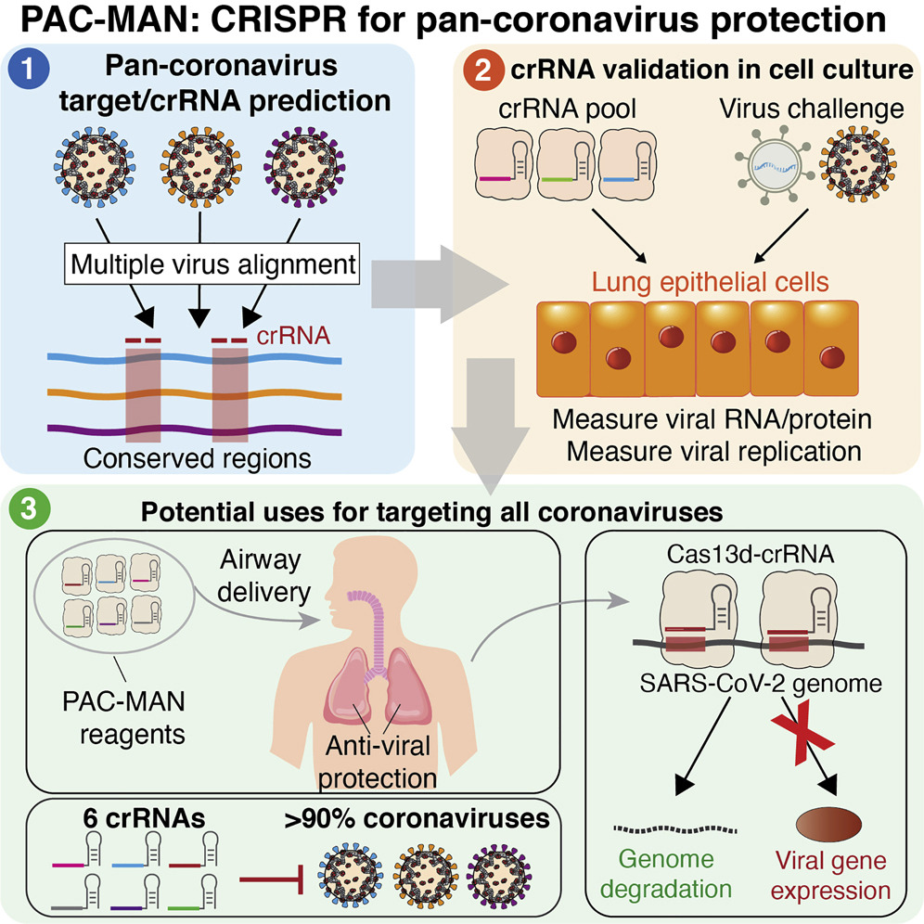
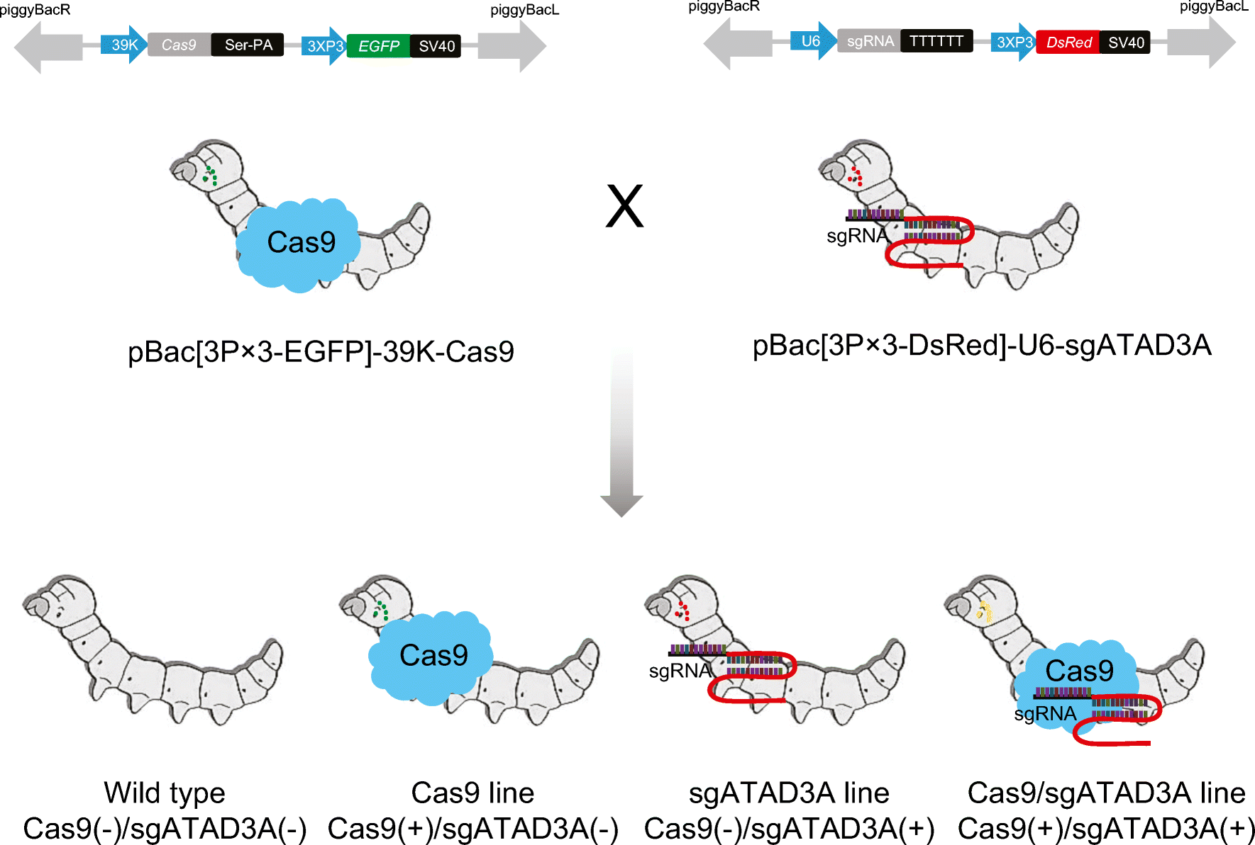
WHY CRISPR ?
Abbott et al, Cell, 2020
Dong et al, Applied Microbiology and Biotechnology, 2018

Slide 6
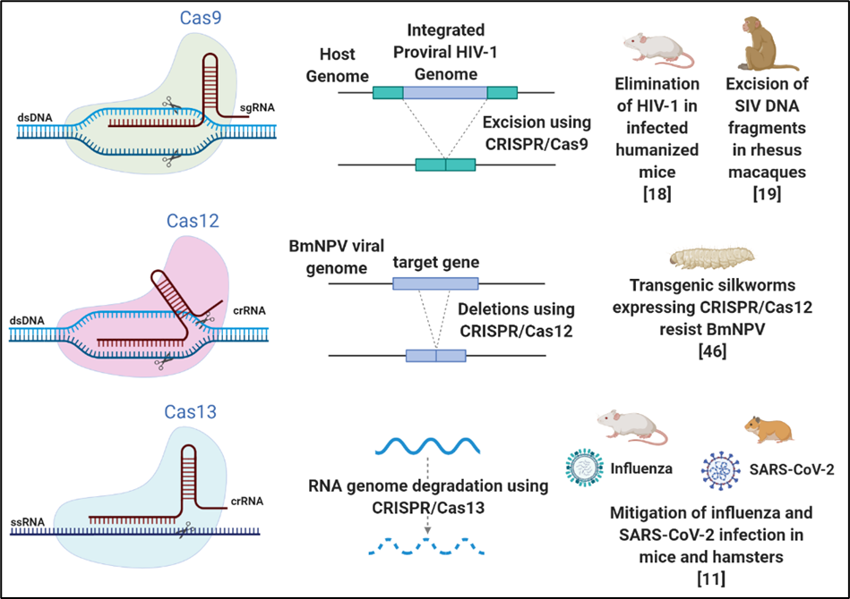
CLASS II CRISPR/CAS SYSTEMS
There are 3 systems:
1. Cas9 (Type II)
G-rich PAM
2. Cas12 (Type V)
Cas12a (Cpf1), b
5’ end located PAM
3. Cas13 (Type VI)
Cas13a, b, c
Cis and trans cleavage

Slide 7
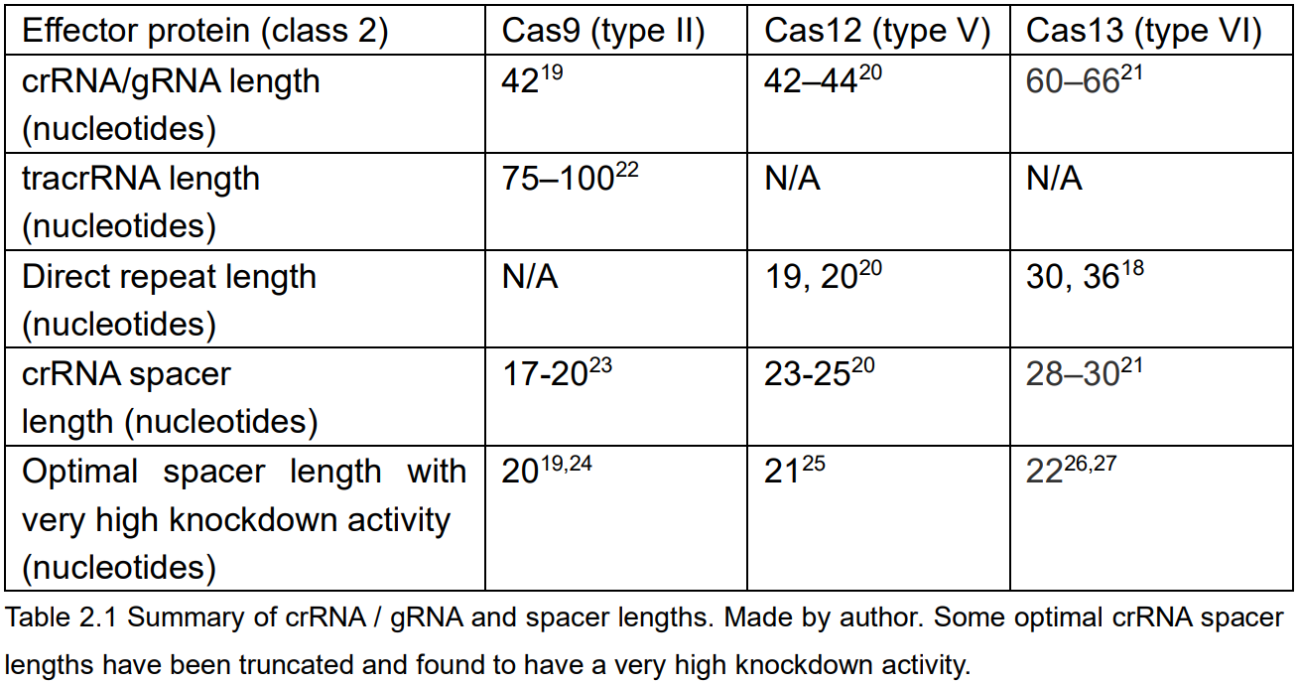
Crispr rnas
Cas9
tracrRNA + sgRNA
Cas12
crRNA + direct repeat
Cas13
crRNA + direct repeat

Slide 8
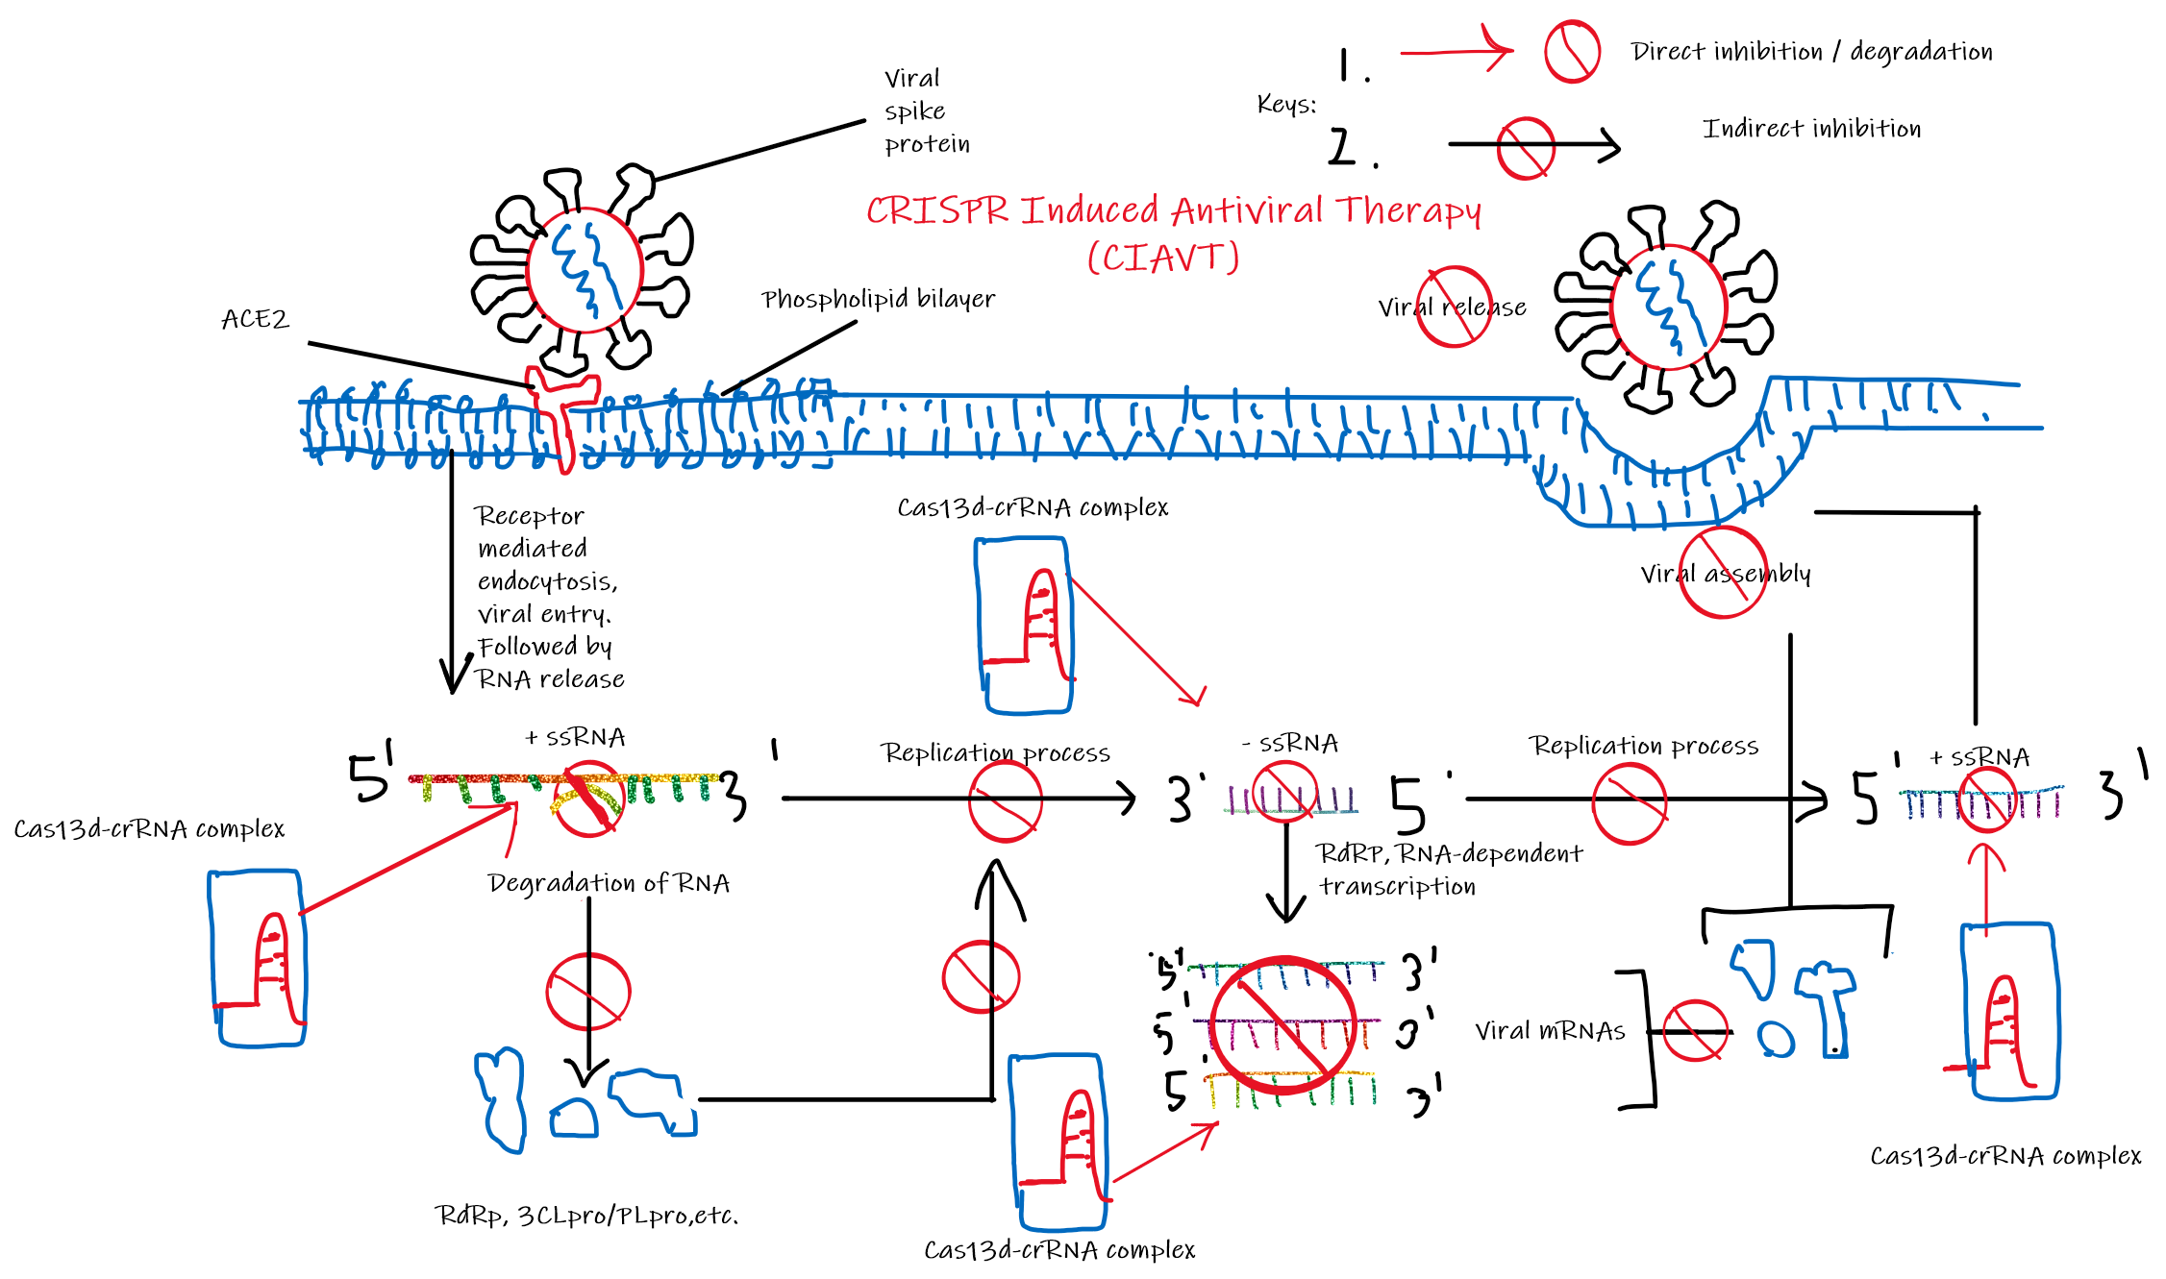
SARS-COV-2

Slide 9
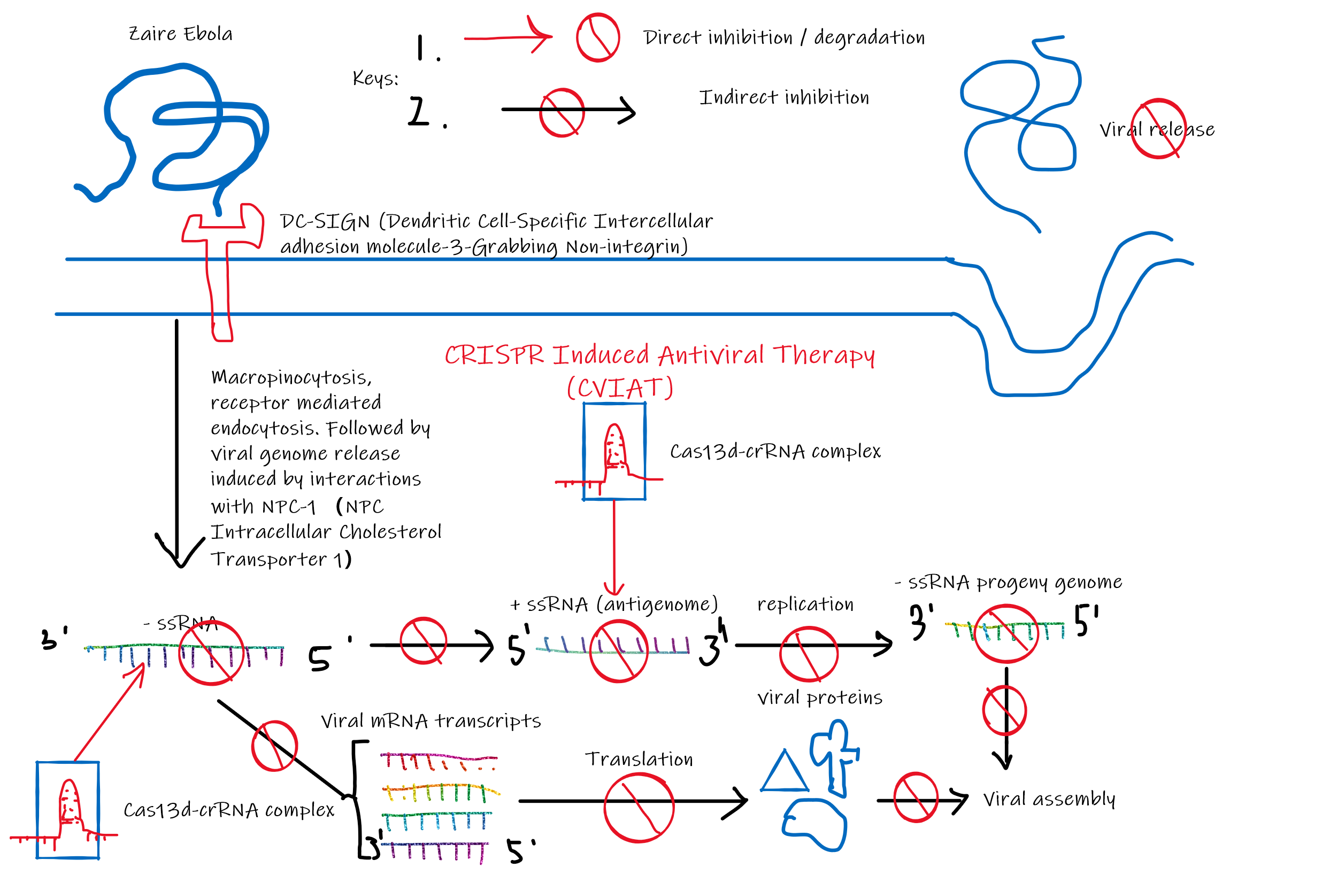
Zaire EBOLA

Slide 10
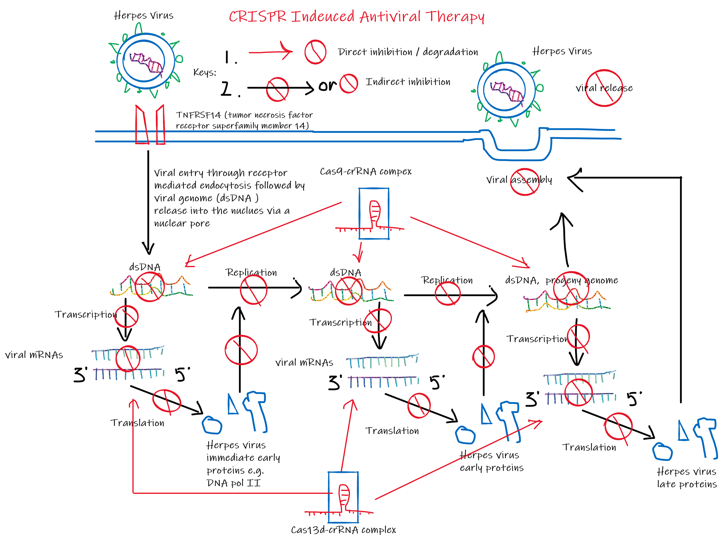
Herpes virus

Slide 11
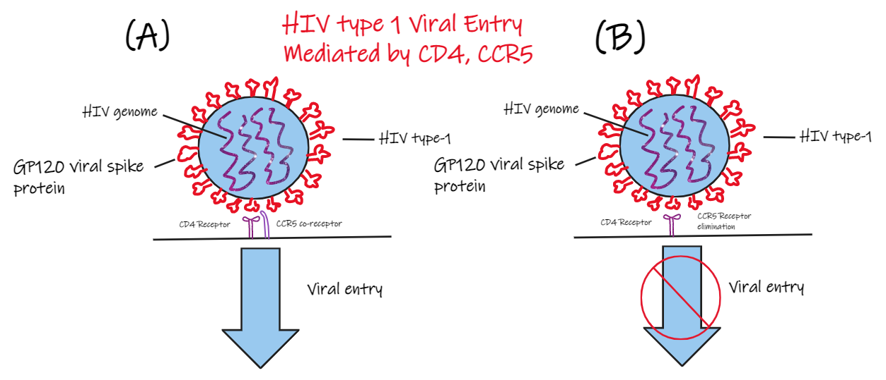
HOST FACTOR OR VIRAL GENOME ?
There are 2 general targets that we could target:
1. Host factors
Side effects may occur
Could be surprisingly very effective
2. Viral genome
More direct approach
Strong suppression

Slide 12
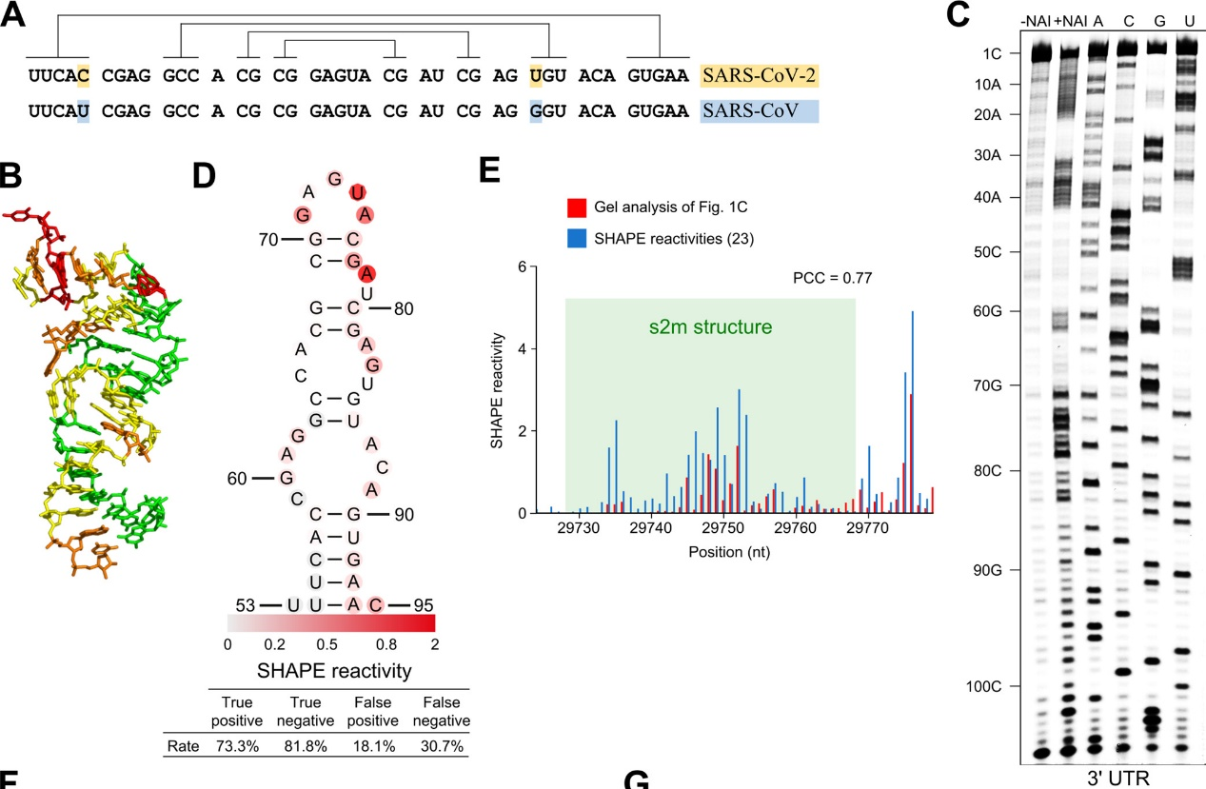
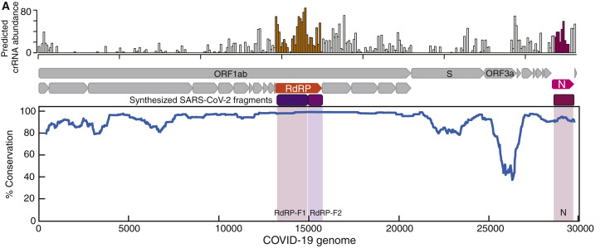
crISPR RNA SELECTION
The quality of crRNA dictates the effectiveness of the therapy / vaccine.
1. crRNA must target highly conserved regions

Slide 13
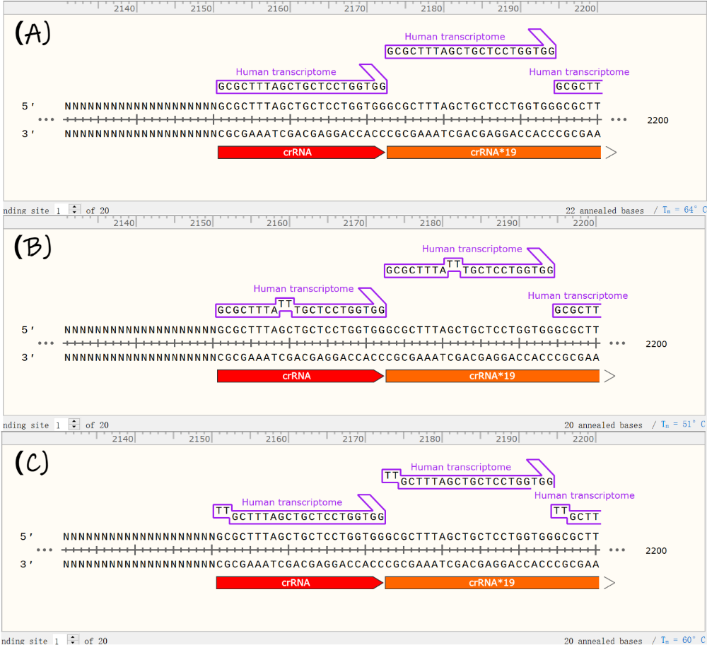
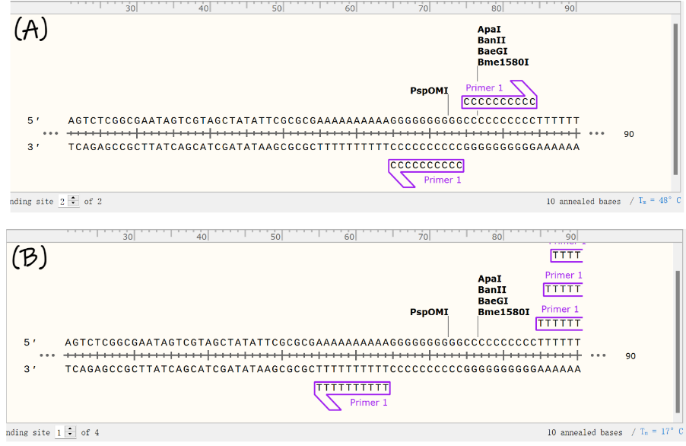
crISPR RNA SELECTION
2. No poly-Uracil sequences (more than 3
3. Minimise potential off-target activity
Annealing temperature of at least 10°C lower with any human transcriptome

Slide 14
crISPR RNA SELECTION
4. Target sequence and crRNA should have an annealing temperature of around 55°C or higher.
5. Spacer sequence 40% < GC <60%
6. Target sequence should ideally be a near perfect match with its variants and SARS-CoV.
Reinforces idea about conserveness
Ensures that mutations will not lead to evasion

Slide 15
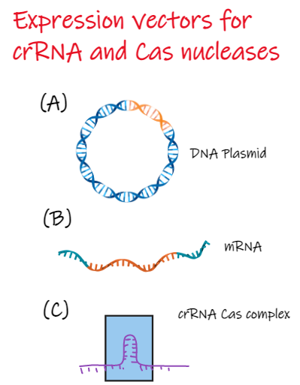
Expression in target cells
Three possible candidates:
1. DNA Plasmid
Long half-life
DNA Integration risk
2. mRNA
Short half-life
3. crRNA Cas complex
Straight forward
But too BIG

Slide 16
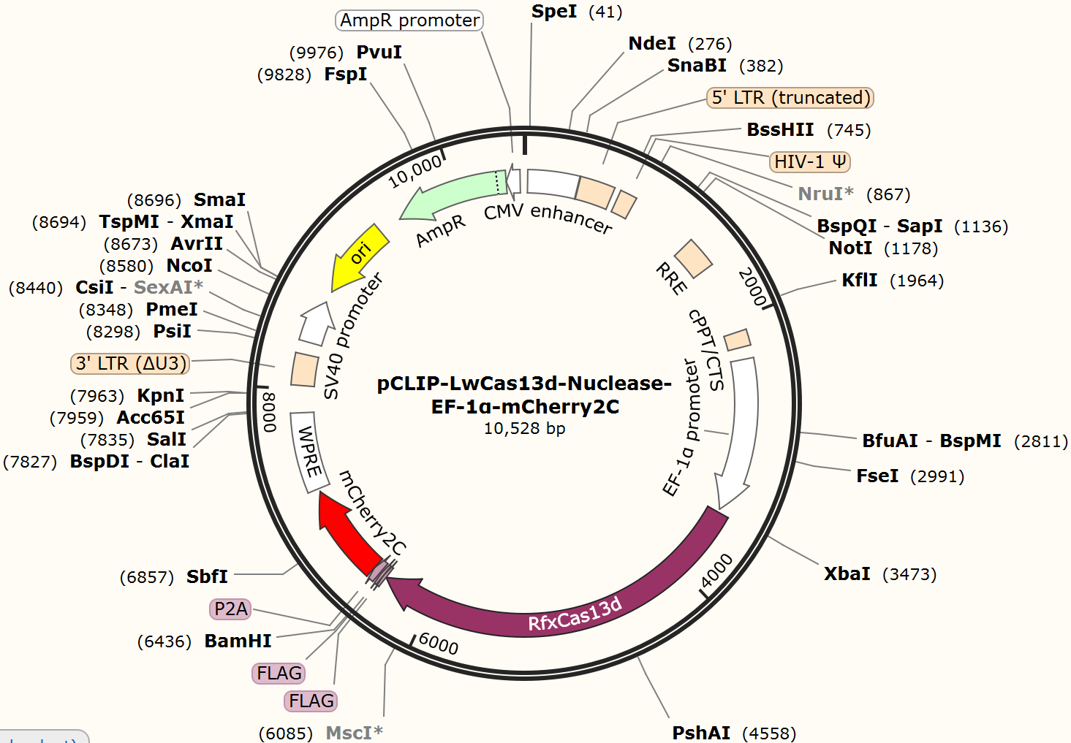
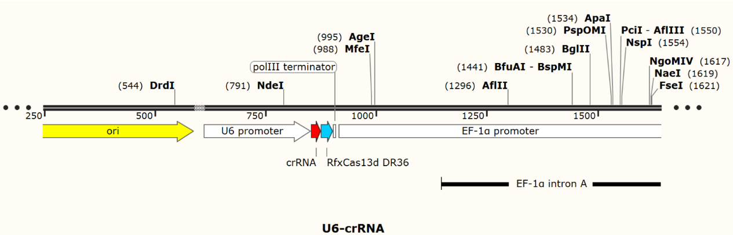
Design of dna plasmid expression vectors
Strong Promoters must be used
Fluorescent label if for research

Slide 17
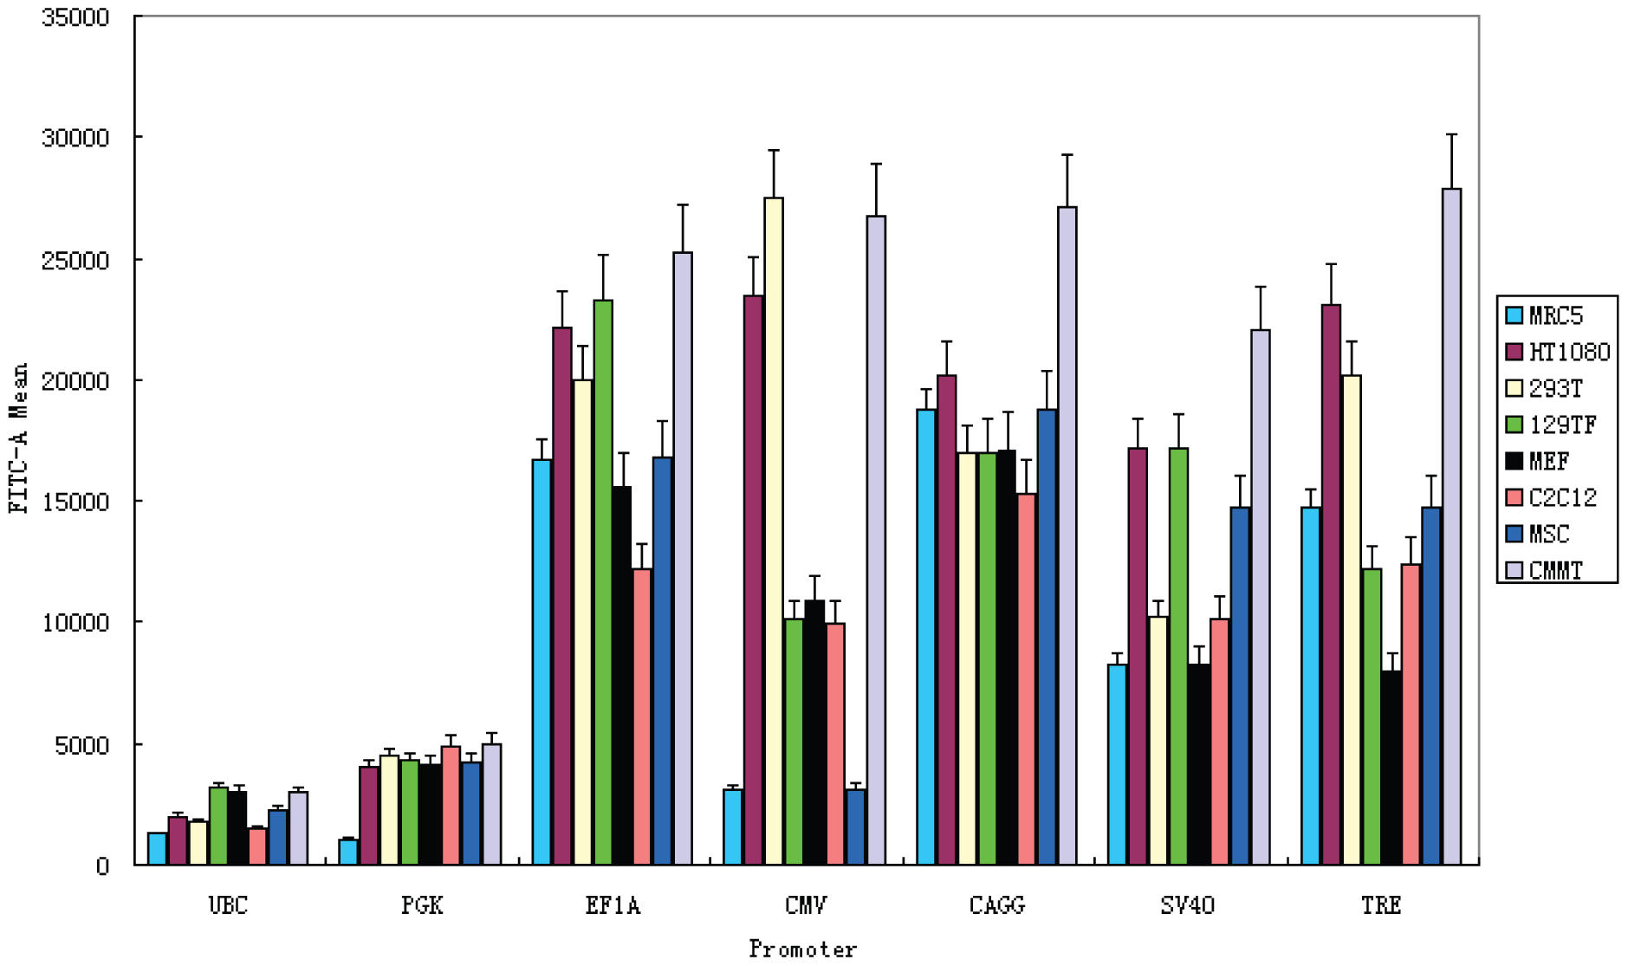
SELECTION OF PROMOTERS

Slide 18
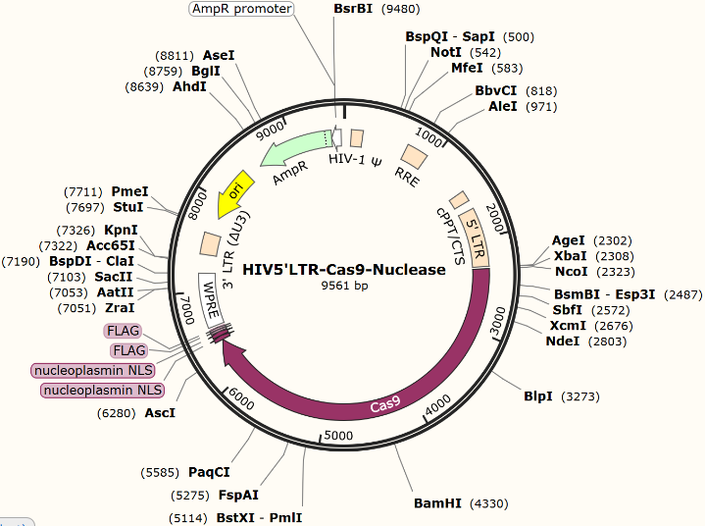
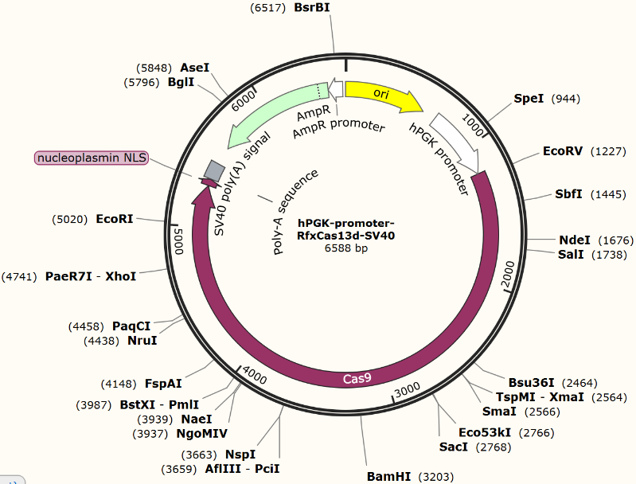
Expression vectors for HIV-1

Slide 19
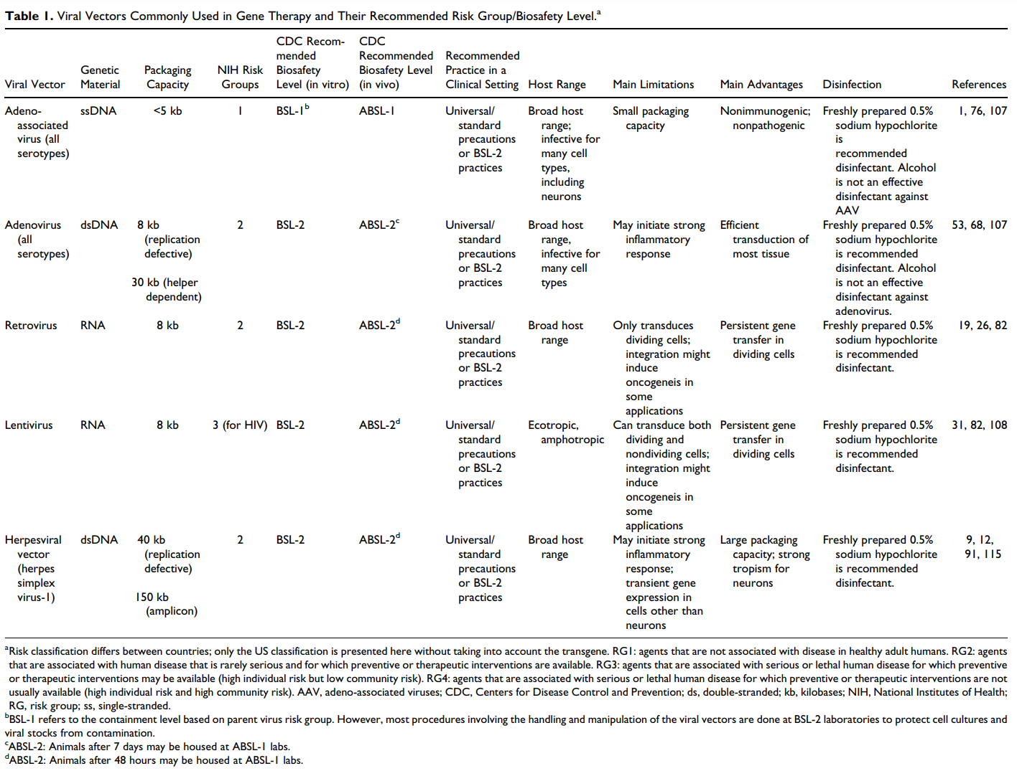
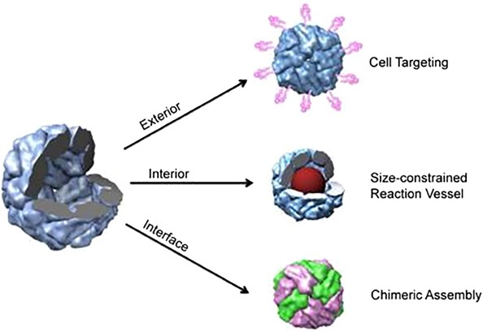
Delivering the plasmids
Viral vectors
Immune response
Specific target
Nanocages
Protein
Inorganic
Exosomes

Slide 20
CRISPR IN BOMBYX MORI

Slide 21
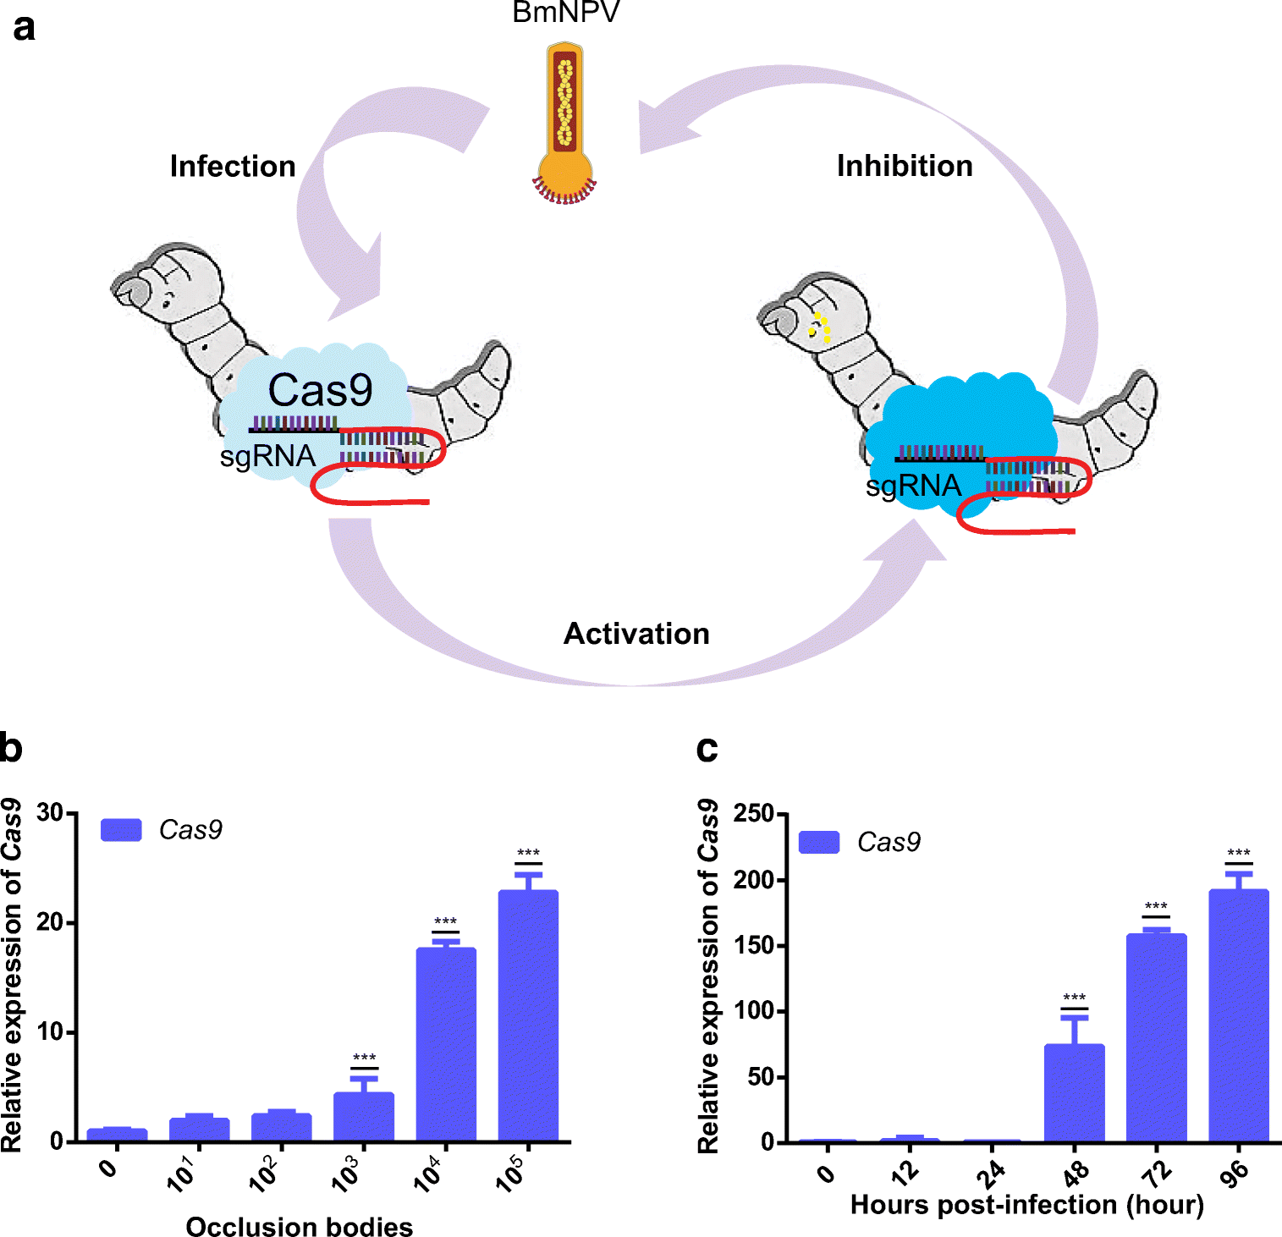
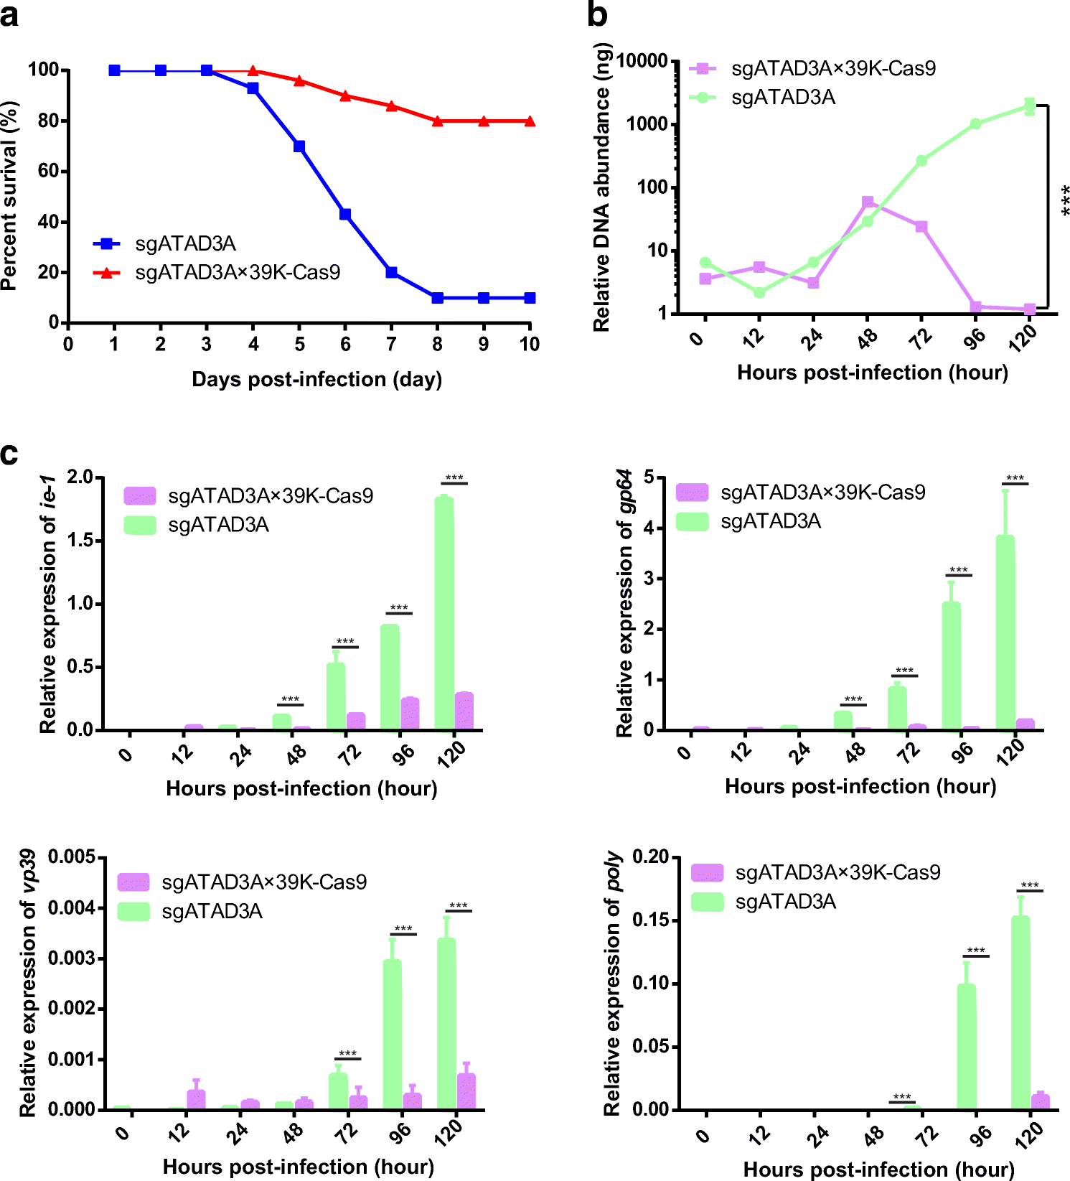

Slide 22
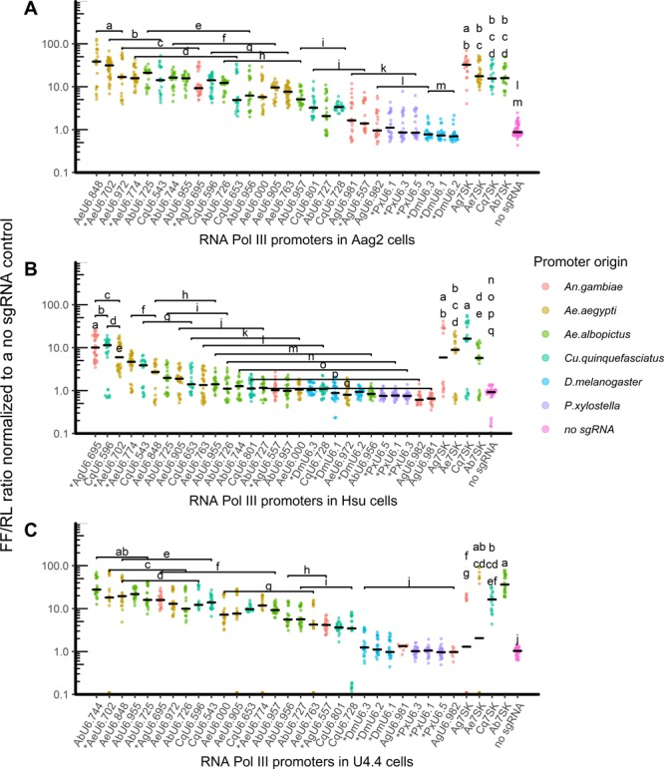
ELIMINATING VIRUSES IN AEDES AEGYPTI
Reduce vectorial capacity of the common vector Aedes aegypti.
Answer for insecticide resistant mosquitos?
It is a mosquito ... nobody cares about mosquitos ...
Control various diseases
Yellow fever virus, Zika virus etc.

Slide 23
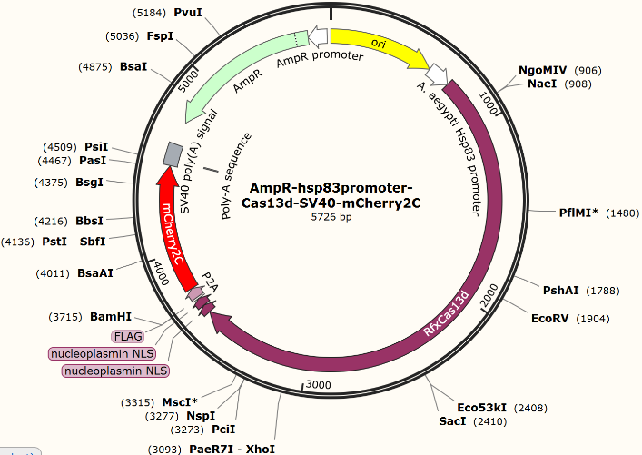
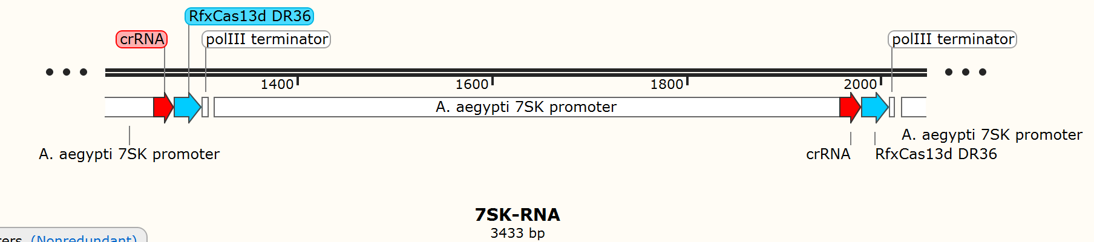
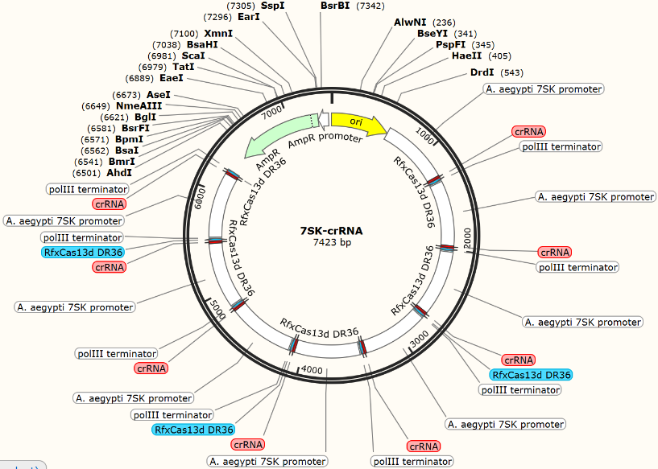
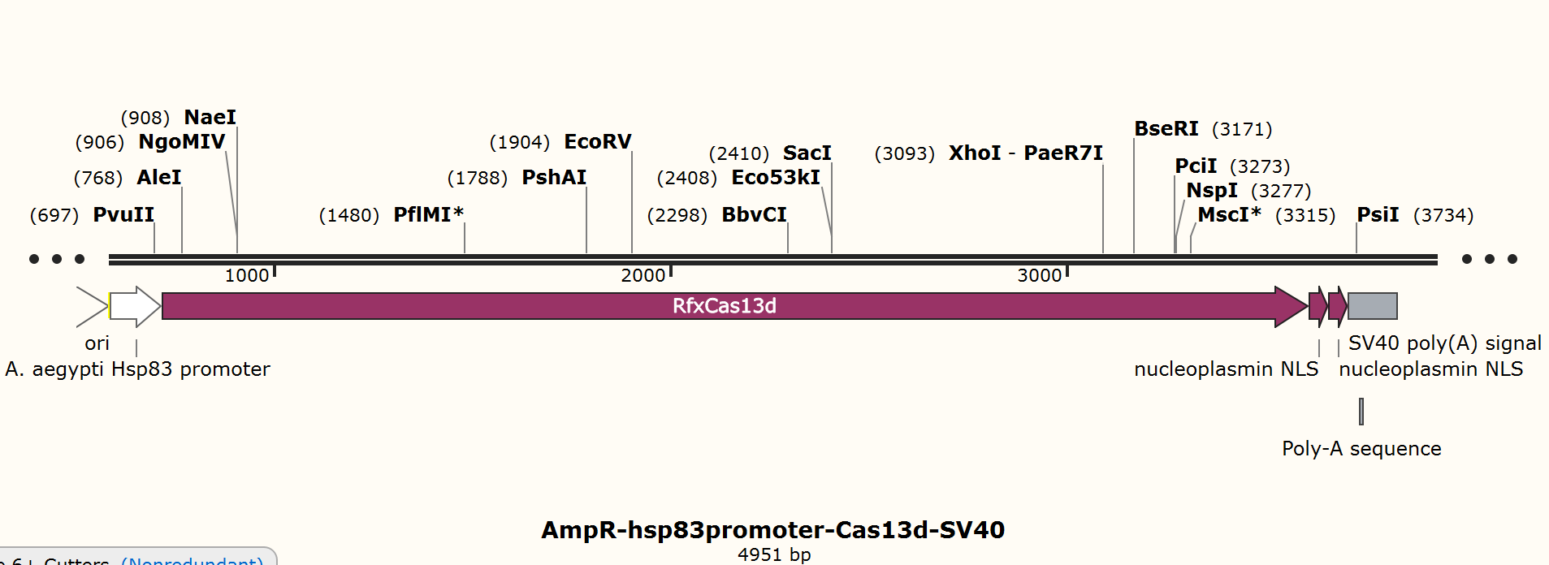

Slide 24
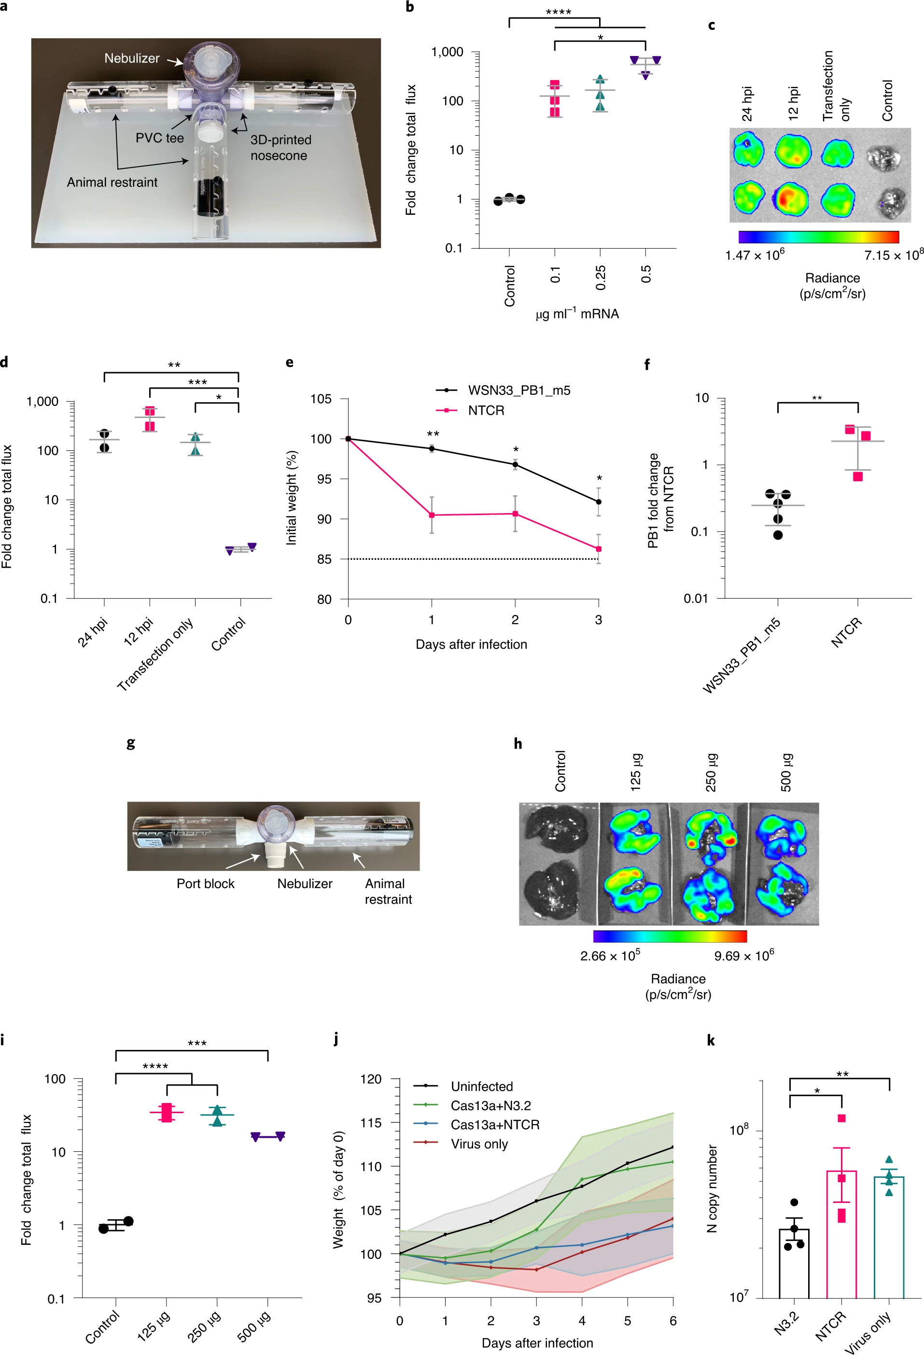
CAS 13 AGAINST SARS-COV IN VIVO
Blanchard et al, Nature Biotechnology, 2021

Slide 25
STATSTICAL
TESTING
One way ANOVA: **P = 0.0016
Tukey’s honest significant difference test *P = 0.0198
Done on log-transferred data.
Blanchard et al, Nature Biotechnology, 2021

Slide 26
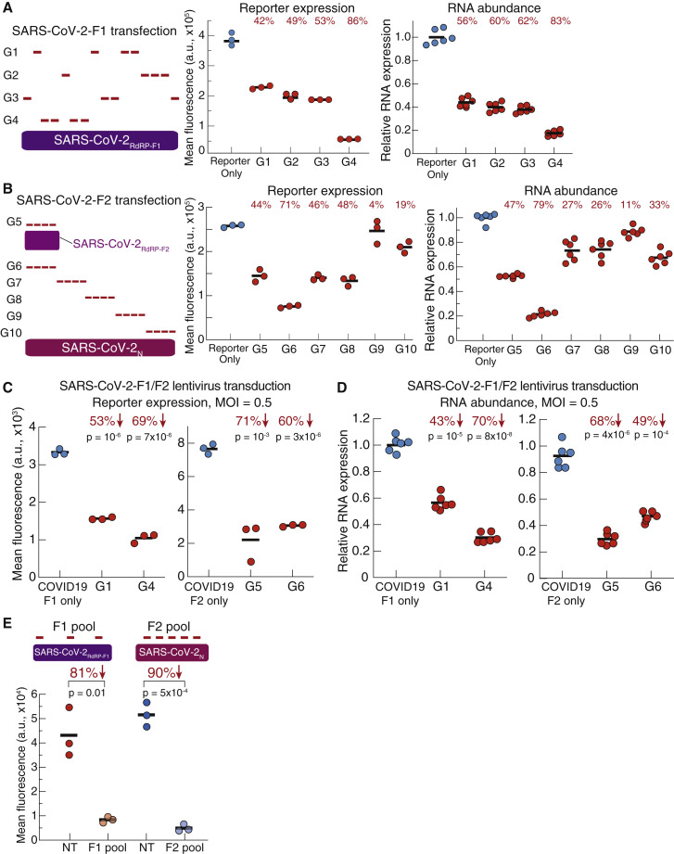
CAS 13 AGAINST SARS-COV-2 IN VITRO

Slide 27
TARGETING SARS-COV-2
Using the instructions I had made, I constructed a crRNA sequence to target the SARS-CoV-2 RdRp RNA sequence.
Highly conserved through multiple alignment data
From the ORF1ab section
crRNA spacer sequence: GUACUGAUGUCGUAUACAGGGC

Slide 28
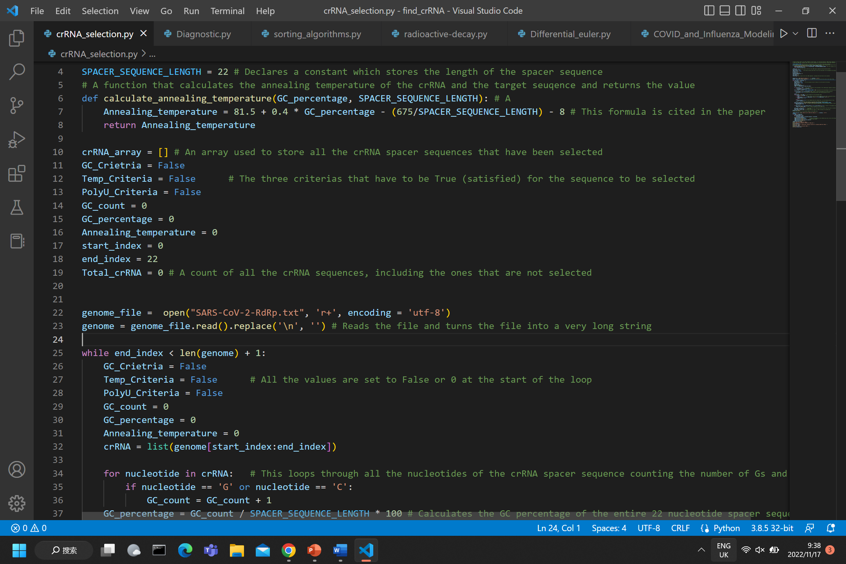
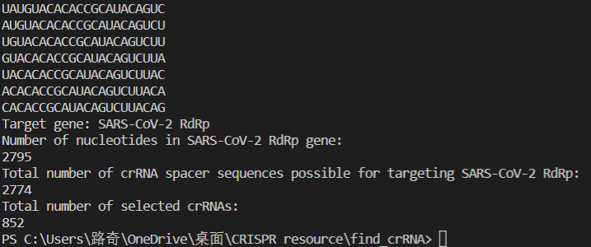

Slide 29

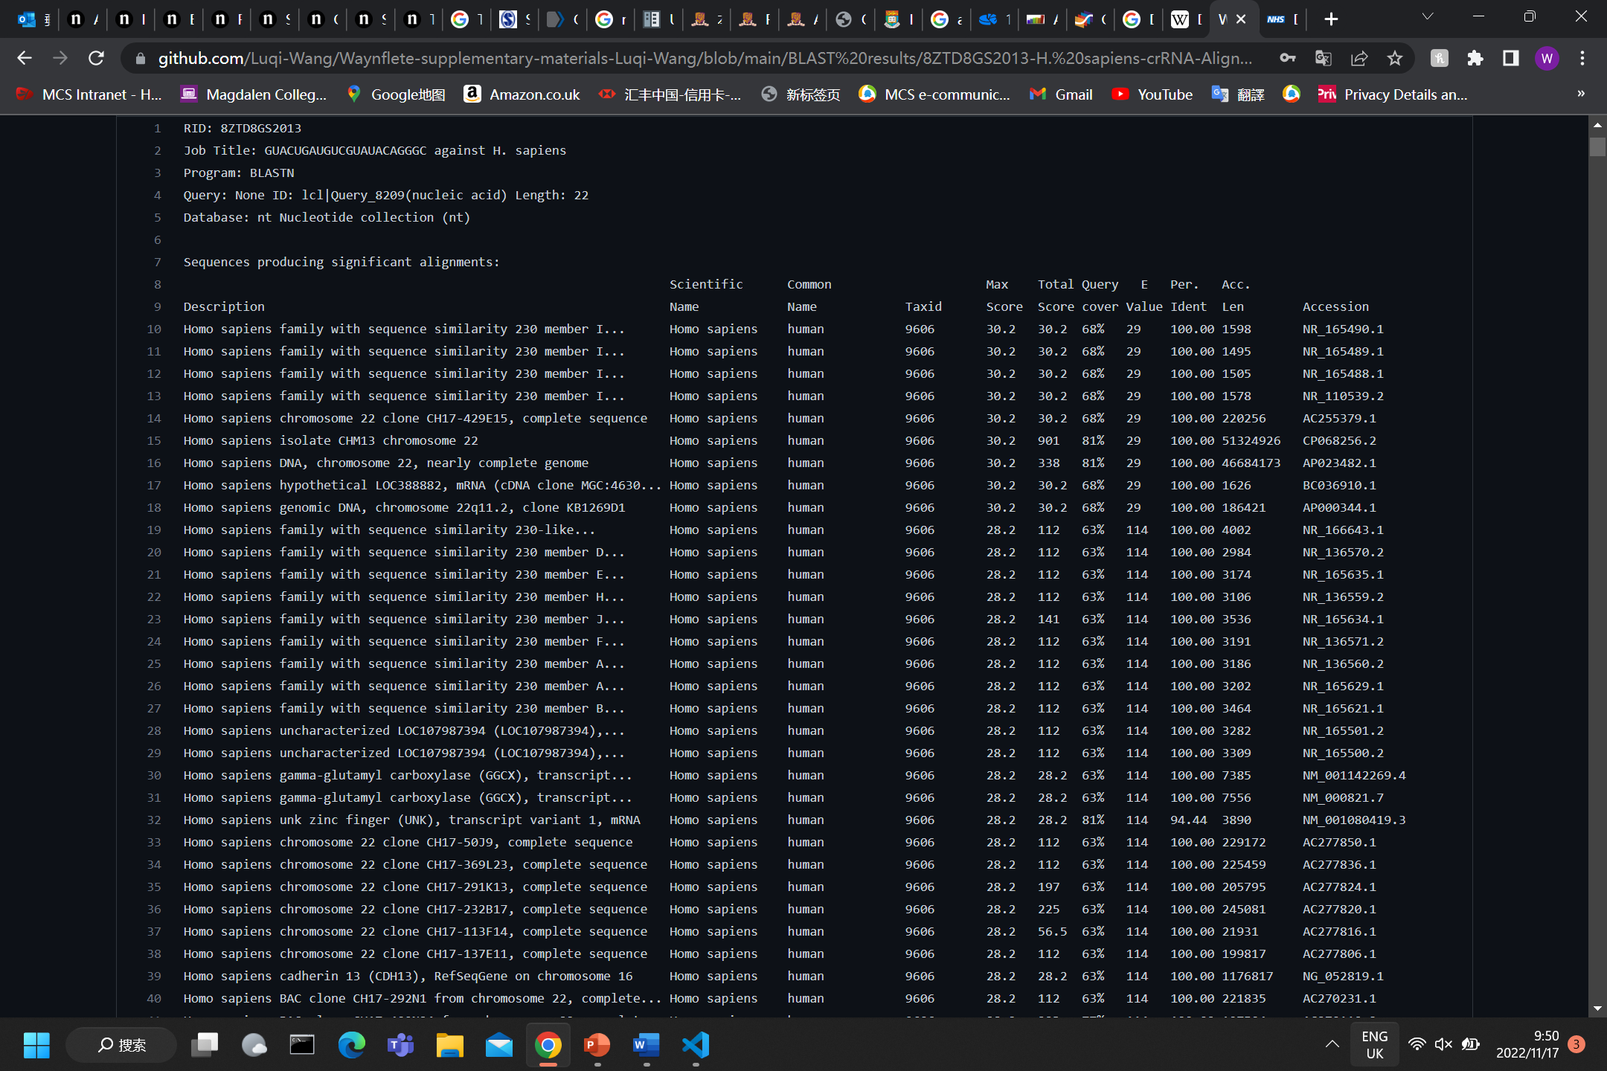
MULTI-BLAST against homo
sapiens
BLAST (Basic Local Alignment Search Tool)
Used align DNA/RNA sequences between species.
For the 852 potential crRNAs I did a BLAST
I went through the scores and alignment values of each and selected the lowest alignment score.

Slide 30
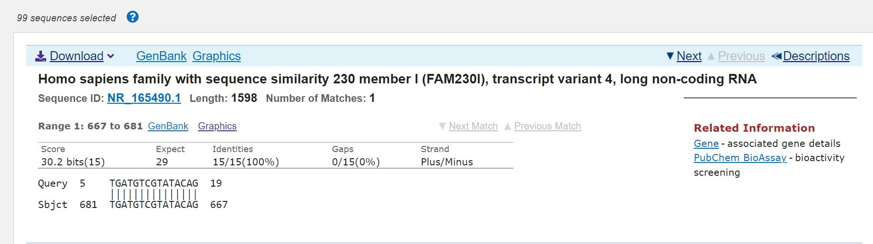
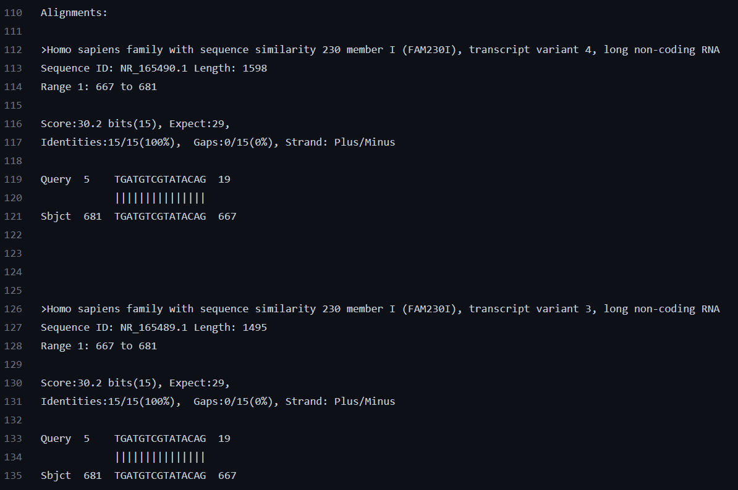

Slide 31
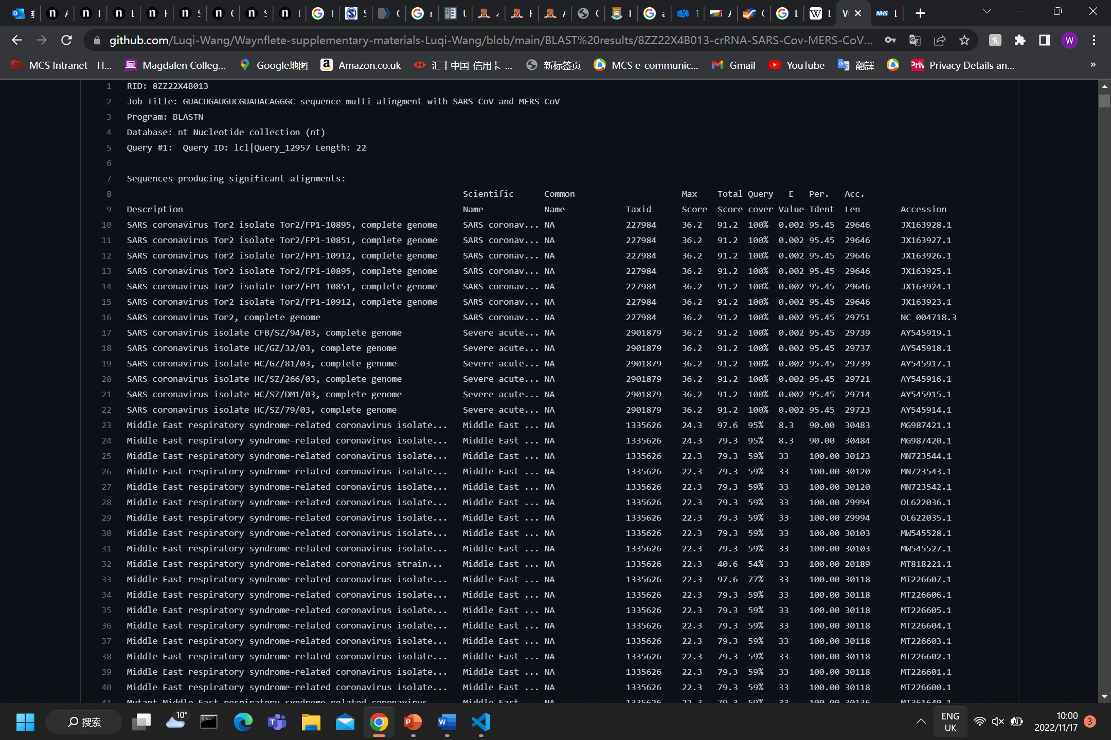
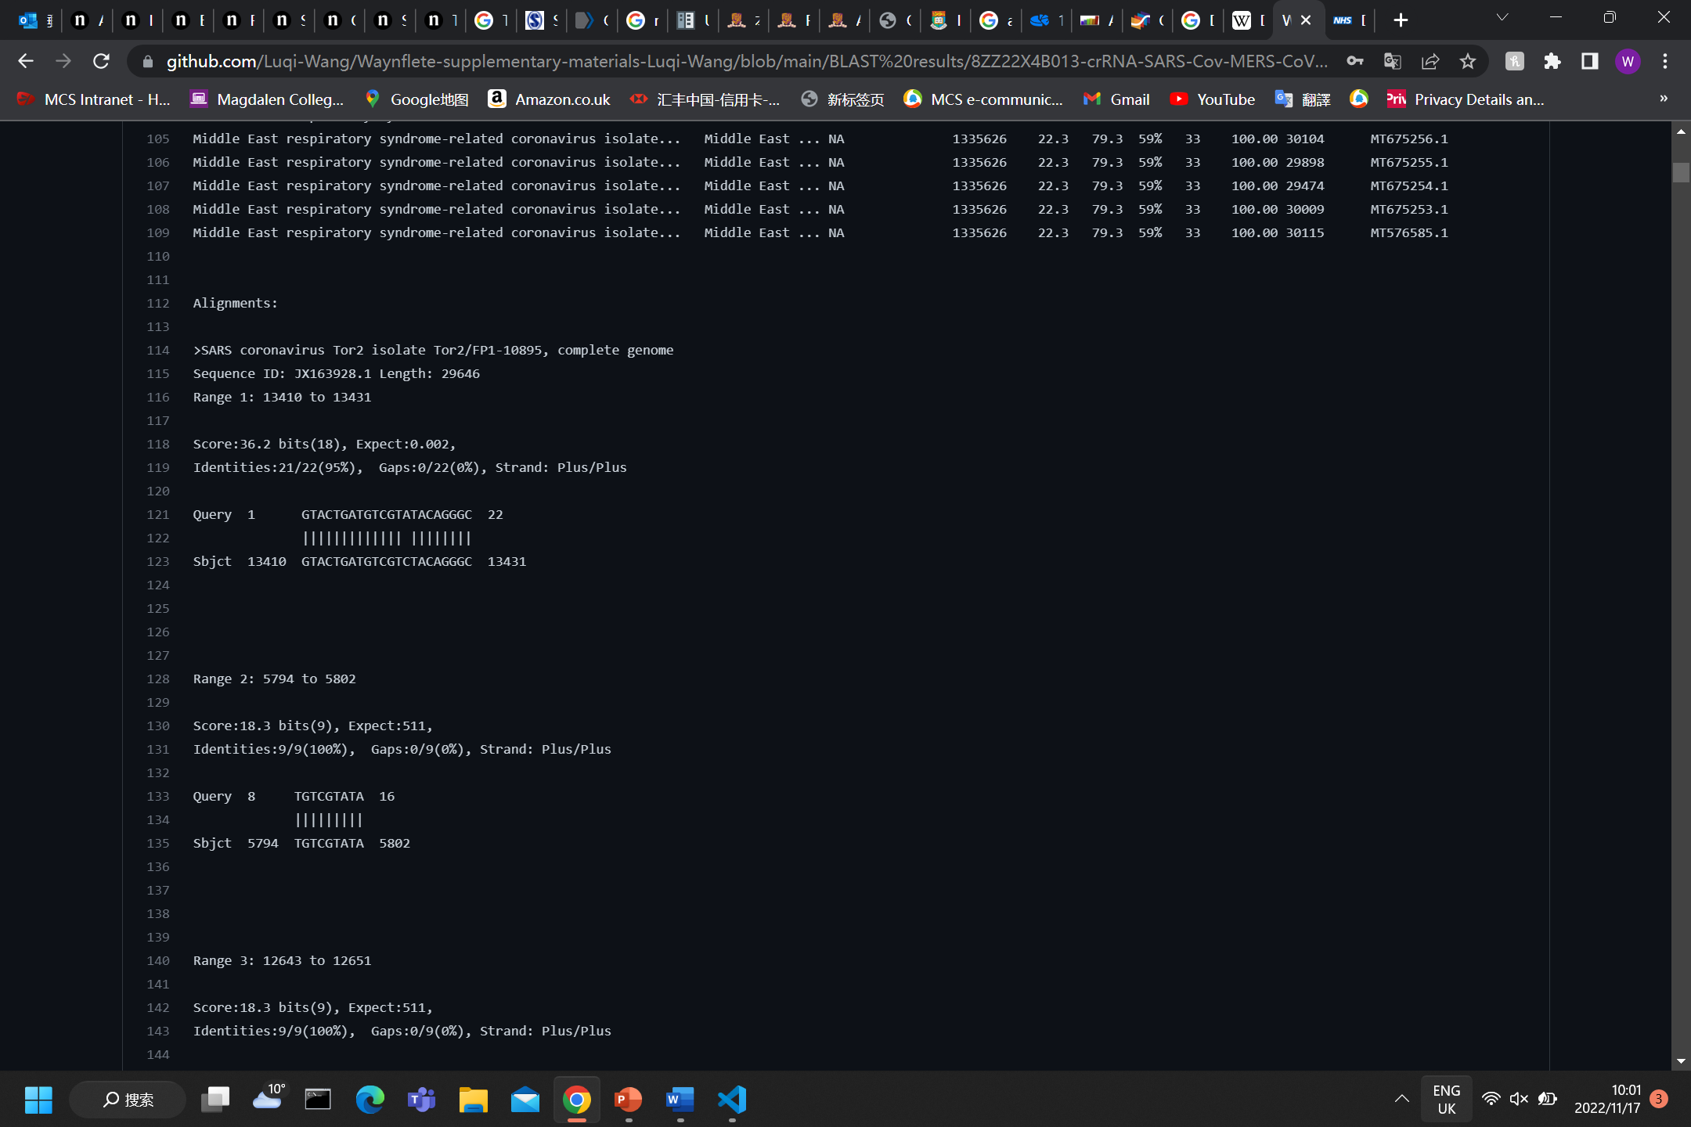
MULTI-BLAST against sars
and mers
BLAST (Basic Local Alignment Search Tool)
Used align DNA/RNA sequences between species.
Highest alignment score selected

Slide 32
conclusions
A very promising technology
Very flexible, short time period to develop.
Its effectiveness already proven in animals (Bombyx mori) and plants.
Effectiveness already proven in mouse, and human cells in vivo, suggests could also work in humans.
Strong suppression of viral load.

Slide 33


